Slide 1
Potential devices for discharge testing
Kai Jarosch
  Plain City OH, Sept-21-2015
Background for Orange Ultrasonics

Slide 2
Reactor for testing discharge approaches
Pilot reactor (old style) – VPP-2
  Three coolant layers
  Two process layers
    Each layer made up of 3 separate waveforms
  Catalyst is was not given optimal post operative treatment
    Represents a ‘difficult’ discharge case
Single waveform
  Contains single waveform between two endplates
  Catalyst treated to simulate impact of operation
    Core size with header (ex tubing): 25.25”x8.06”x2.75
    Core only: 24”x 7.756”x 2.25”
    Weight (ex catalyst): ~120 lb
    Core catalyst volume: 554 ml

Slide 3
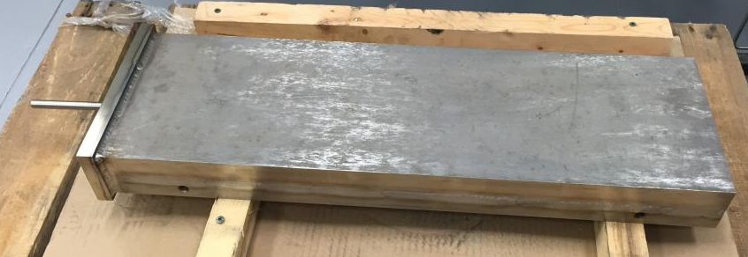
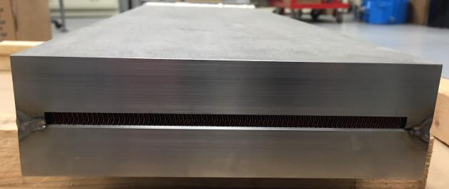
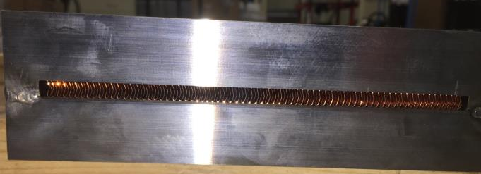
Single waveform device
Overview
Open face
Open face

Slide 4
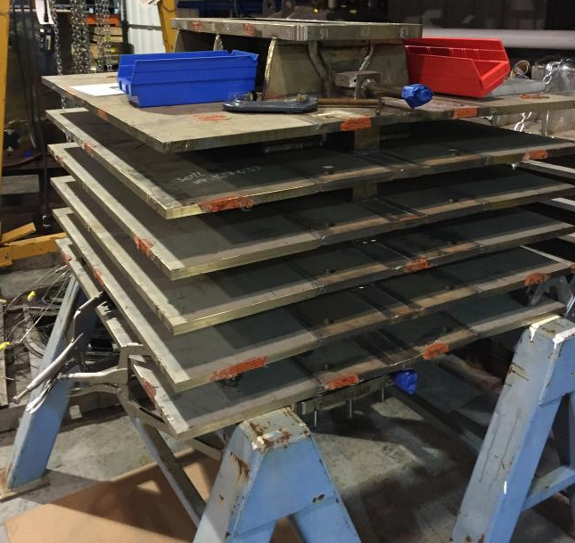
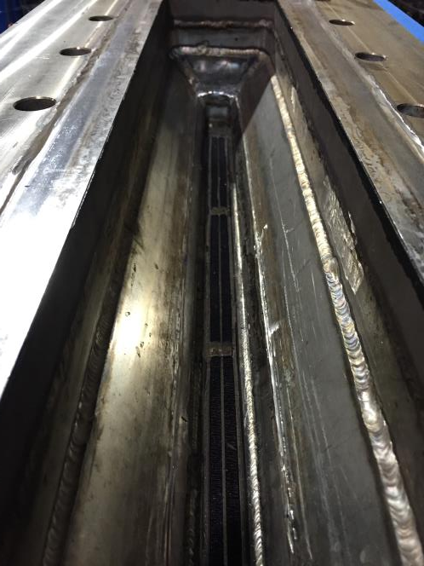
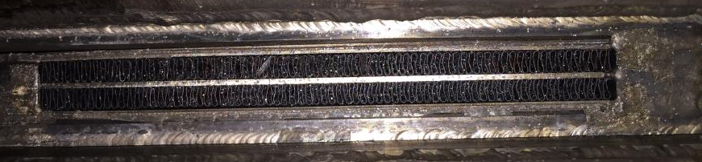
VPP-2 pilot reactor
Header
External view
Waveform pair

